Slide 1
Neural Networks
(Multi Layer Perceptrons)
Swetanjal Dutta

Slide 2
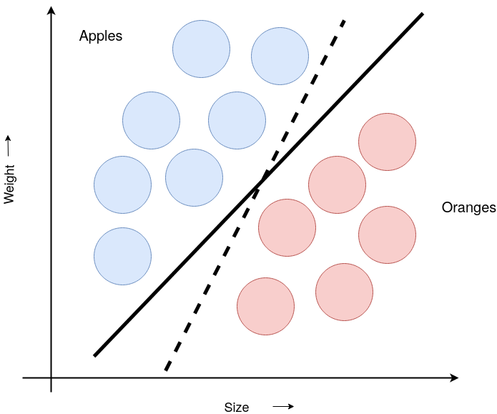
Perceptron
Classifying apples and oranges

Slide 3
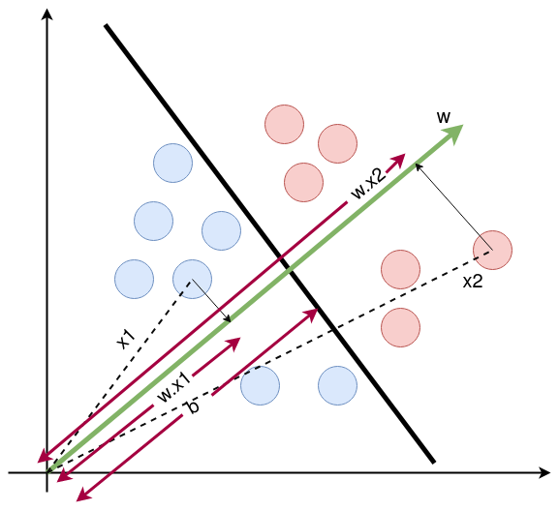
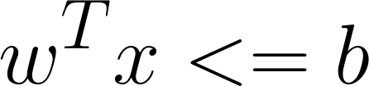
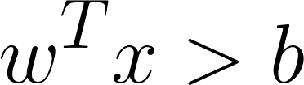
Learnable parameters w, b
, Classify as -1
, Classify as +1
Notation: Red circles have label +1 and blue circles have label -1

Slide 4
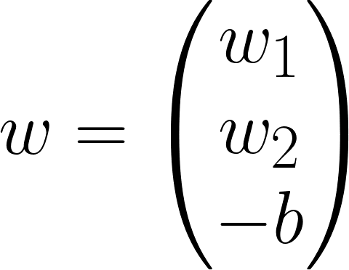
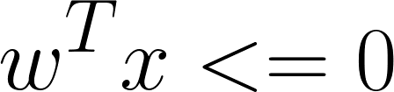
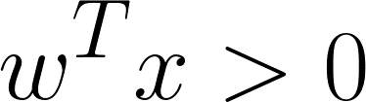
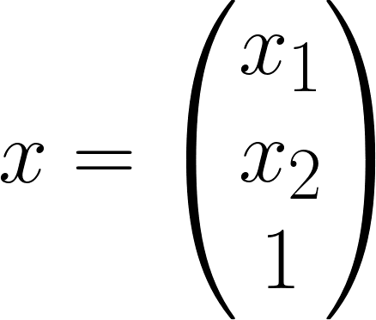
Absorbing the b into w vector and adding 1 to x
where,

Slide 5
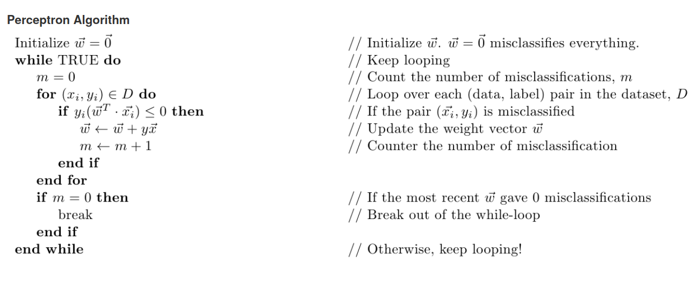

Slide 6
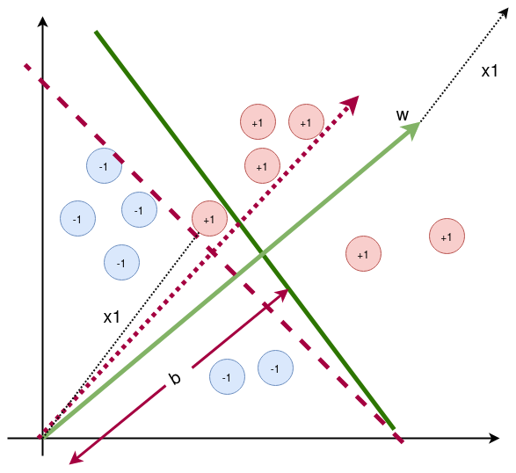
Intuition on Training the perceptron
Misclassifying a sample with label +1
How can I change my w and b so that my perceptron gets the sample correct?
Increase or decrease b?
Add x to w or subtract x from w?
Does this agree with the above algorithm?

Slide 7
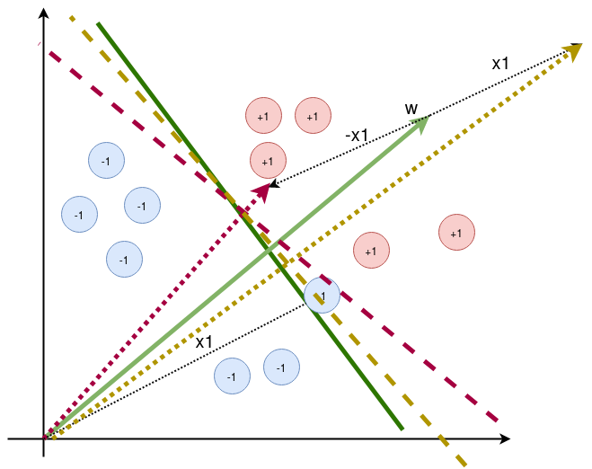
Intuition on Training the perceptron
Misclassifying a sample with label -1
How can I change my w and b so that my perceptron gets the sample correct?
Increase or decrease b?
Add x to w or subtract x from w?
Does this agree with the above algorithm?

Slide 8
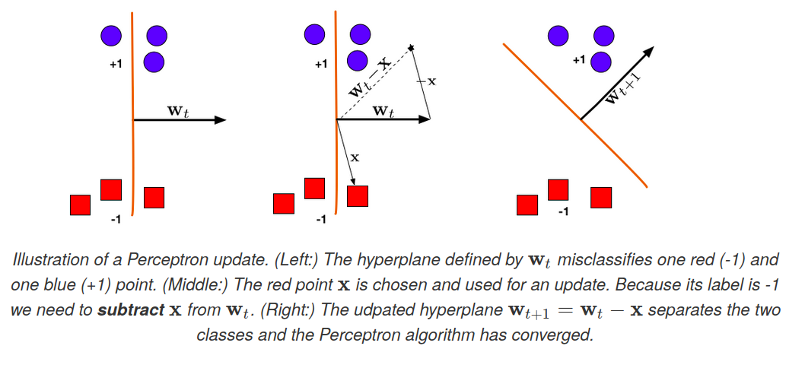
Another Geometric intuition example

Slide 9
To avoid the line from moving drastically during the training process, we use a learning rate

Slide 10
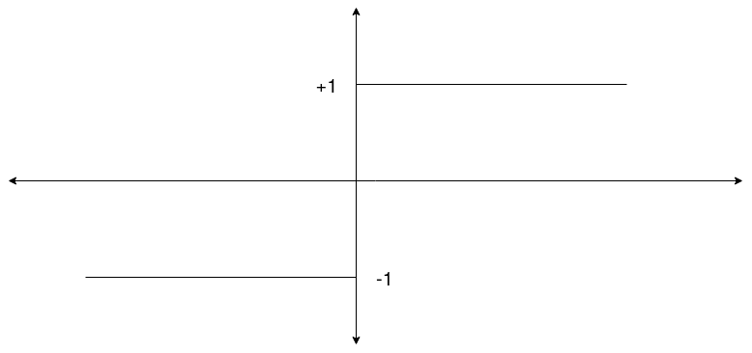
The perceptron predicts:
sign(w.x)
In other words, it passes the value of w.x through a step activation function and outputs +1 or -1.

Slide 11
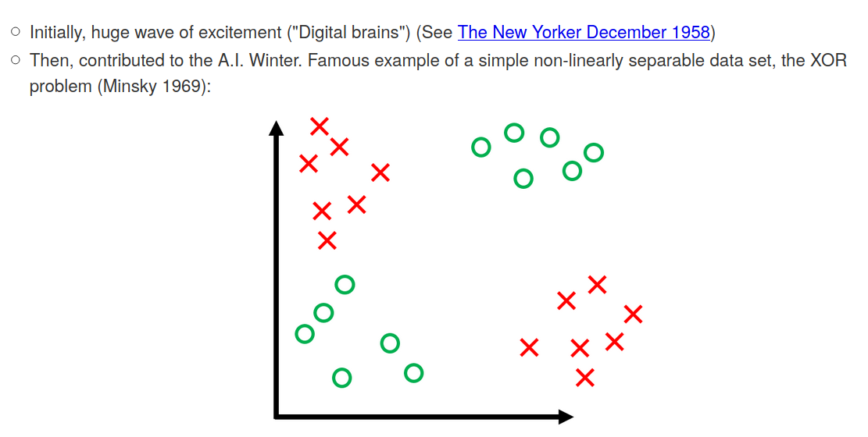
Limitations of Perceptron Algorithm

Slide 12
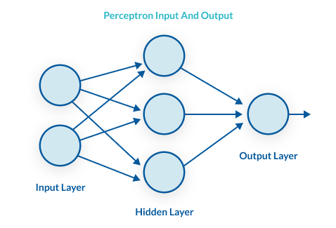
Can we solve the non linearity issue by stacking up many perceptrons?
Not really!
It will still be a linear classifier

Slide 13
Add a non linearity instead of the step function after each perceptron node
This happens to solve the non linearity issue.
Adding these non linearities after every perceptron node, along with the hidden layers in the architecture help us approximate any function(Universal Approximation Theorem)
What are the non linearities available?
ReLU
tanh
Sigmoid which is a continuous version of the step function
Leaky ReLU

Slide 14
To train a complicated network like this we need something more formal!

Slide 15
Loss Function
Loss Function measures how well my model fits the training set.
If the problem is a linear regression problem, mean square error can be used as a loss function.
If the problem is a classification problem, we cannot use mean square error as the loss function. This is because MSE is non convex in classification problems.

Slide 16
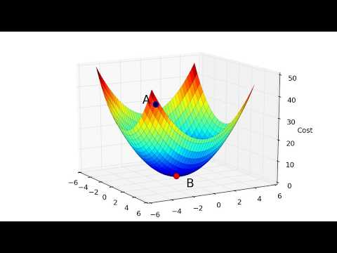
Optimize the loss function using Gradient Descent

